Slide 1
Verbs, Glorious Verbs
A Resource for Writing Learning Objectives

Slide 2
Effective Outcomes
Learning outcomes are not about what the instructors can provide, but what the students can demonstrate.
When writing a measurable learning outcome, it is important to:
focus on student behavior
use simple, specific action verbs
select appropriate assessment methods
state desired performance criteria

Slide 3
Writing Learning Outcomes
Typically we employ a stem phrase in stating outcomes:
e.g. The student will be able to…
A graduate of this program shall be able to…
What follows that phrase is an active verb drawn from one of three domains:
Cognitive - knowledge and dealing with that knowledge
Affective - beliefs, attitudes values
Psycho-motor – sequence of motion, prescribed task

Slide 4
Focus on the Observable
Observable Performance
write
praise
operate
analyze
organize
demonstrate
describe
Non-observable Performance
understand
know
learn
remember
enjoy
perceive
become familiar with

Slide 5
Checklist for writing learning outcomes
Focus on outcomes, not processes
Start each outcome with an action verb
Use only one action verb per learning outcome
Avoid vague verbs such as know and understand
Check that the verbs used reflect the level of learning required
Ensure that outcomes are observable and measurable
Write the outcomes in terms of what the learner does, not what the instructor does
Check that the outcomes reflect knowledge, skills, or attitudes required in society and the workplace
Include outcomes that are woven into the entire course (such as work effectively in teams)
Check that there are the appropriate number of outcomes (no more than three per major topic)
List the sub-outcomes (learning tasks) for each outcome
Check that the outcomes fit within your program and TWU SLO’s
Adapted from http://kb.bcit.ca/files/articles/fsr/teach/courseprep/ja_learningoutcomes.pdf

Slide 6
Bloom’s Taxonomy
The Work of Bloom (1956) and Anderson and Krathwohl (2001) has given a way of thinking about various levels of learning in three domains .
Cognitive domain - knowledge and dealing with that knowledge
Affective domain - beliefs, attitudes values
Psycho-motor domain - sequence of motion, prescribed task

Slide 7
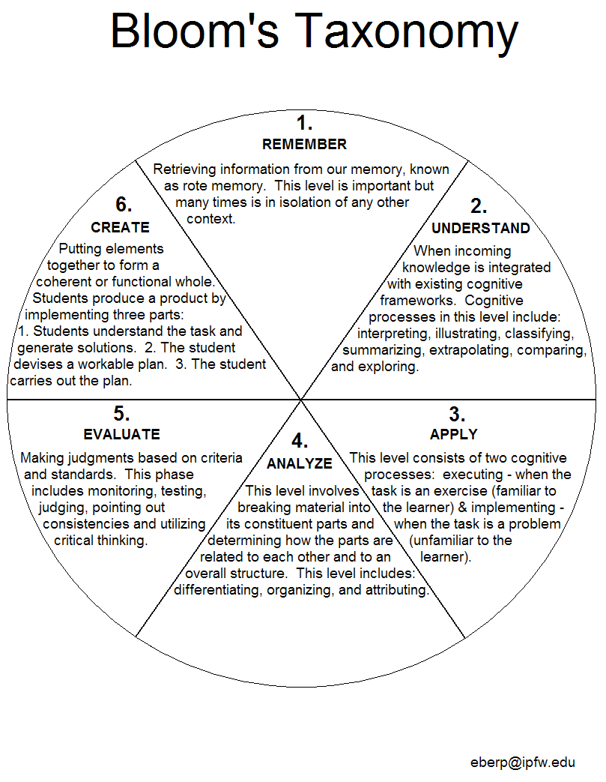
A Taxonomy for the Cognitive Domain

Slide 8
Cognitive Domain
Category | Associated Verbs/Actions
Remember | Recall, remember, match, select, identify, choose, order, outline
Understand | Plot, define, summarize, classify, describe, present, explain
Apply | Propose, audit, edit, predict, construct, use, show, solve, compute
Analyze | Distinguish, differentiate, investigate, scrutinize, consider, question
Evaluate | Appraise, assess, judge, critique, comment, examine, interrogate
Create | Develop, design, devise, generate, propose, build, form, assemble

Slide 9
Affective & Psychomotor Domains As with the Cognitive domain there are levels of learning
Psychomotor Domain | Affective Domain
1. Imitation | 1. Receiving
2. Manipulation | 2. Responding
3. Precision | 3. Valuing
4. Articulation | 4. Organization
5. Naturalization | 5. Characterization

Slide 10
Simple Outcomes Verbs
Psychomotor | Cognitive | Affective
Demonstrate | Cite | Accommodate
Distinguish | Copy | Ask
Complete | Define | Describe
Hear | Explain | Follow
Identify | Identify | Give
Locate | Indicate | Hold
Move | Itemize | Identify
Practice | Label | Listen
Point to | List | Locate
Press | Locate | Name
Pull | Match | Point
Push | Mate | Respond
See | Name | Select
Select | Outline
Set up | Quote
Show | Recite
Specify | Recognize
Sort | Respond
Touch | Reproduce
 | Repeat
 | Report
 | Restate
 | Select
 | State
 | Say
 | Specify
 | Translate

Slide 11
Intermediate Outcomes Verbs
Psychomotor | Cognitive | Affective
Assemble Activate | Apply Convert Demonstrate | Assist Approve Choose
Adjust
Build Calibrate Close | Distinguish Draft Dramatize | Commend Complete Comply
Construct Copy | Draw Employ | Conform Describe
Demonstrate | Estimate | Form
Disassemble | Explain | Follow
Disconnect | Extend | Initiate
Draw | Generalize | Invite
Duplicate | Give Example | Join
Execute Fasten | Illustrate Infer | Justify Perform
Fix | Operate | Practice
Grasp | Paraphrase | Propose
Insert Lift | Predict Prepare | Share Study
Locate | Rewrite | Work
Loosen | Schedule
Load | Summarize
Manipulate | Use
Measure
Open Operate
Perform Remove
Replace Rotate
Set Slide
Signal
Tighten
Trace
Turn
Twist

Slide 12
Complex Outcomes Verbs
Psychomotor | Cognitive | Affective
Devise | Assess | Act
Generate | Analyse | Adapt
Organize | Compare | Adhere
Plan | Conclude | Change
Repair | Contrast | Defend
Adapt | Convert | Display
Combine | Create | Influence
Compose | Criticize | Integrate
Construct | Compose | Mediate
Design | Design | Organize
 | Diagram | Revise
 | Discriminate | Solve
 | Differentiate | Verify
 | Evaluate
 | Formulate
 | Generate
 | Manipulate
 | Modify
 | Organize
 | Originate
 | Plan
 | Predict
 | Prepare
 | Propose
 | Rate
 | Select
 | Value

Slide 13
Verbs Related to Particular Tasks
Producing a Sequence of Words
Dealing with two or more stimuli
Using concepts
Producing a single isolated response
Producing a sequence of motion
Using principles
Combining two or more principles
Information Collection and Processing Work
Decision-making Work

Slide 14
Producing a Sequence of Words
to cite
to copy
to enumerate
to letter
to list
to quote
to recite
to record
to reiterate
to repeat
to reproduce
to (re)state
to transcribe
to type
to choose

Slide 15
Dealing with two or more stimuli
to compare
to contrast
to couple
to decide
to detect
to differentiate
to discern
to distinguish
to isolate
to judge
to match
to mate
to pair
to pick
to recognize
to select

Slide 16
Using concepts
to allocate
to arrange
to assign
to catalogue
to categorize
to characterize
to classify
to collect
to divide
to file
to grade
to group
to index
to inventory
to itemize
to order
to rank
to rate
to reject
to screen
to sort
to specify
to survey
to tabulate

Slide 17
Producing a single isolated response
to associate
to give a word for
to grasp (w/ hand)
to hold
to identify
to indicate
to label
to lift
to locate
to loosen
to move
to name
to pick up
to place
to press
to pull
to recognize
to repeat
to reply
to respond
to rotate
to set
to signal
to slide
to tighten
to touch
to twist

Slide 18
Producing a Sequence of Motion
to activate
to adjust
to align
to close
to copy
to (dis)assemble
to (dis)connect
to draw
to duplicate
to insert
to load
to manipulate
to measure
to open
to operate
to remove
to stencil
to trace
to tune
to turn off/on

Slide 19
Using Principles
to anticipate
to calculate
to calibrate
to check
to compile
to compute
to conclude
to construct
to convert
to coordinate
to correct
to deduce
to define
to demonstrate
to design
to determine
to diagram
to equate
to estimate
to evaluate
to examine
to expect
to explain
to extrapolate

Slide 20
Using Principles
to figure
to foresee
to generalize
to illustrate
to infer
to interpolate
to interpret
to monitor
to organize
to plan
to predict
to prescribe
to program
to project
to schedule
to solve
to translate
to verify

Slide 21
Combining two or more principles
to accommodate
to adapt
to adjust to
to analyze
to compose
to contrive
to correlate
to create
to develop
to devise
to diagnose
to discover
to find a way
to invent
to realize
to reason
to resolve
to study
to synthesize
to think through
to troubleshoot

Slide 22
Supervisory and Management Work
advise
analyze
appraise
approve
assess
assign
compare
conduct
contact
counsel
determine
diagnose
draft
establish
estimate
forecast
implement
initiate
interpret
Interview
Investigate
maintain

Slide 23
Supervisory and Management Work
manage
monitor
negotiate
observe
orient
participate
perform
plan
prepare
process
recommend
review
schedule
sign
study
submit
supervise
verify

Slide 24
Information Collection and Processing Work
analyze
ascertain
audit
calculate
check
compile
compute
confer
consult
count
diagnose
gather
identify
inspect
interview
inventory
locate
measure
observe
obtain

Slide 25
Information Collection and Processing Work
proof
receive
review
verify
weight

Slide 26
Decision-making Work
approve
compare
decide
determine
estimate
evaluate
judge
rate
test

Slide 27
Further Resources
Unless otherwise noted, the above is adapted from PIDP 3210 Curriculum Development, British Columbia Provincial Instructor Diploma Program, a program of the Ministry of Advanced Education, Innovation and Technology and offered by Vancouver Community College.
See also:
http://www.assessment.uconn.edu/docs/HowToWriteObjectivesOutcomes.pdf
For other Faculty Development Resources head to :
www.twu.ca
Research
Faculty Development
Events and Services
Teaching Tip Bulletins

